Slide 1
SECTION: DNA Expanded Metrics
n=63 samples | Valid values° (DNA samples) | median (min; max)
Total number of reads passing filter (u) | 40 | 181M (67M; 253M)
Median target coverage (u) | 40 | 705 (96; 1595)
Chimeric reads (%) | 40 | 0.825 (0.050; 4.87)
Exon 100x (%) | 40 | 98.7 (49.6; 99.5)
Read enrichment (%) | 40 | 71.9 (60.3; 82.8)
Reads that contain usable UMI information (%) | 40 | 99.9 (99.8; 99.9)
Mean target coverage (u) | 40 | 721.3 (110.4; 1619.0)
Aligned reads (%) | 40 | 96.55 (55.4; 99.1)
Percent of foreign DNA estimated to be in the sample (%) | 40 | 2 (0.2; 25.7)
Unique reads passing filter(%) | 40 | 100 (100; 100)
Target 04x mean (%) | 40 | 94.95 (64.3; 96.8)
Target 100x (%) | 40 | 98.1 (47.1; 99.4)
Target 250x (%) | 40 | 94.8 (0.4; 98.4)
Note. n: absolute frequencies; u: unit; °non-missing values

Slide 2
SECTION: DNA Expanded Metrics by Unstable MSI sites guideline
n=63 samples | Valid values° (DNA samples) | median (min; max) | Guideline=0 median (min; max) | Guideline =1 median (min; max) | P-value*
 |  |  | (n=7) | (n=33)
Chimeric reads (%) | 40 | 0.825 (0.050; 4.87) | 0.71 (0.05; 1.68) | 0.83 (0.08; 4.87) | 0.233
Aligned reads (%) | 40 | 96.55 (55.4; 99.1) | 81.3 (55.4; 90.9) | 97 (78.3; 99.1) | <0.001
Unique reads passing filter (%) | 40 | 100 (100; 100) | 100 (100; 100) | 100 (100; 100) | 1
Note. n: absolute frequencies; u: unit; °non-missing values; *Mann-Whitney test.

Slide 3
SECTION: RNA Expanded Metrics
n=63 samples | Valid values° (RNA samples) | median (min; max)
Total number of reads passing filter (u) | 35 | 29.9M (12.3M; 30M)
Scaled Median gene coverage (u) | 35 | 5110 (1231; 6534)
Chimeric reads (%) | 35 | 0.18 (0.07; 4.21)
Target reads (%) | 35 | 92.9 (59.2; 96.6)
Note. n: absolute frequencies; u: unit; °non-missing values

Slide 4
SECTION: Copy Number Variations (CNV)
n=63 samples | Valid values° (DNA samples) | median (min; max) | Contamination=0 | Contamination=1 median (min; max) | No P-CNV* median (min; max) | P-CNV* median (min; max) | P-value** No P-CNV vs P-CNV
 |  |  | (n=1) | (n=39) | (n=30) | (n=9)
Contamination score (u) | 40 | 1305 (72; 7416) | 5162 | 1270 (72; 7416) | 417.5 (72; 3025) | 5040 (3766; 7416) | <0.001
Contamination p value (u) | 40 | 0.897 (0; 1) | 0.227 | 0.996 (0; 1) | 1 (0.009; 1) | 0.006 (0; 0.044) | <0.001
Aligned reads (%) | 40 | 96.55 (55.4; 99.1) | 96.3 | 96.6 (55.4; 99.1) | 96.55 (55.4; 99.1) | 96.6 (78.3; 97.7) | 0.881
Read enrichment (%) | 40 | 71.9 (60.3; 82.8) | 68.3 | 72.4 (60.3; 82.8) | 71.9 (63.3; 82.8) | 74.6 (60.3; 80.3) | 0.973
Chimeric reads (%) | 40 | 0.825 (0.050; 4.870) | 0.47 | 0.83 (0.050; 4.870) | 0.925 (0.050; 4.870) | 0.520 (0.080; 2.090) | 0.026
Note. n: absolute frequencies; u: unit; °non-missing values; **P-CNV (Potential CNV): contamination= 1 AND contamination score > 3106, No P-CNV: contamination= 1 AND contamination score ≤ 3106; **Mann-Whitney test.

Slide 5
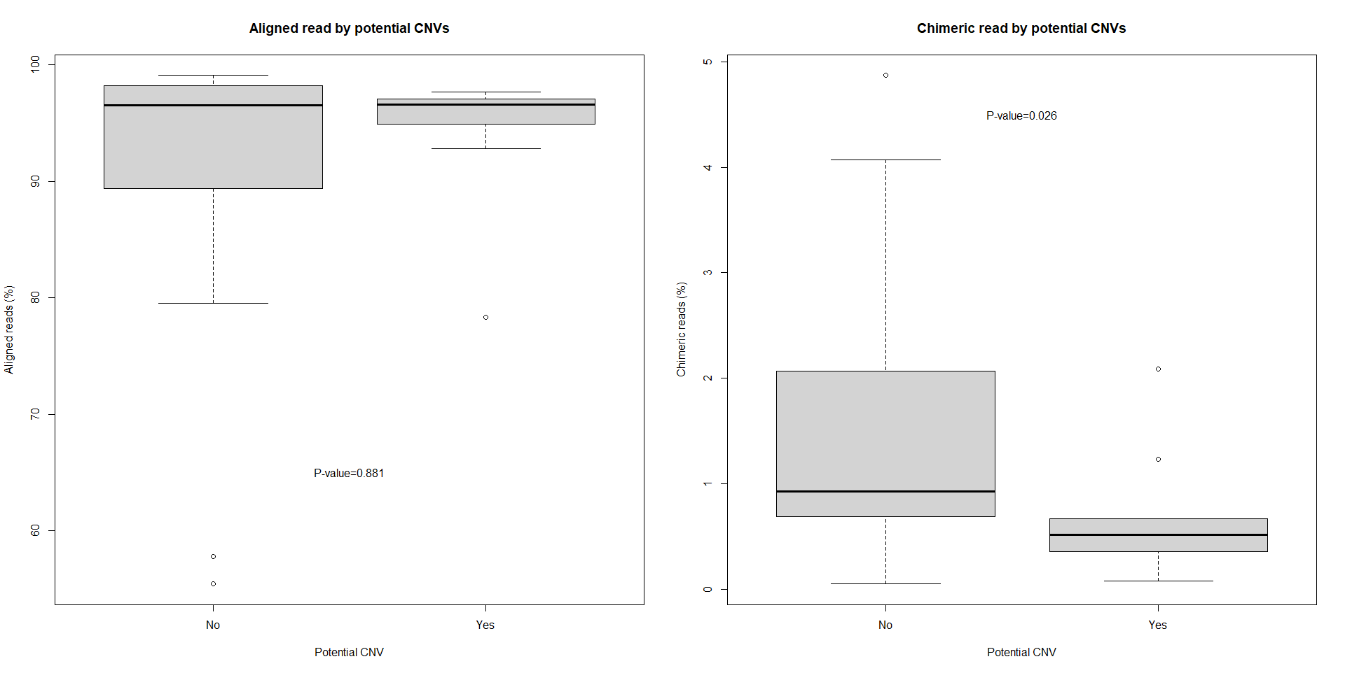
SECTION: Copy Number Variations (relevant plots)

